Slide 1
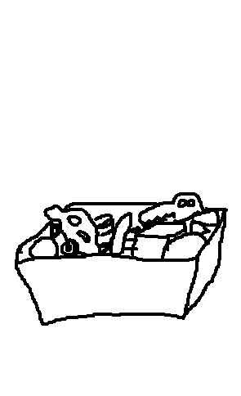
chore chart
www.cuppacocoa.com
Pick up toys.
Brush teeth.
Go potty.
Take a bath.
Put on pajamas.

Slide 2
G
R
E
A
T!

