Slide 1
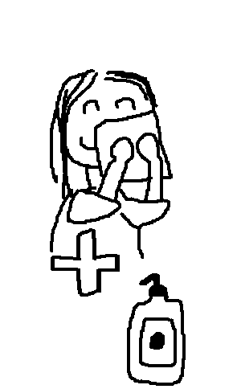
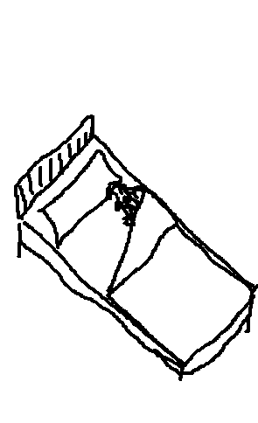
chore chart
www.cuppacocoa.com
Go potty.
Brush teeth.
Wash face and put on lotion.
Get dressed.
Make bed.

Slide 2
S
U
P
E
R!

